Slide 2


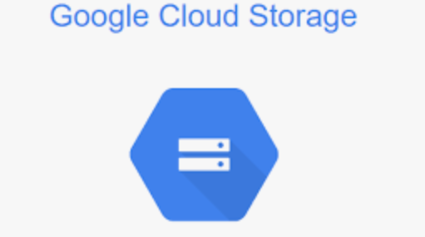







Batch orchestration
infrastructure

